Slide 1
Chapter 5: CPU Scheduling

Slide 2
Outline
Basic Concepts
Scheduling Criteria
Scheduling Algorithms
Multi-Processor Scheduling

Slide 3
Objectives
Describe various CPU scheduling algorithms
Assess CPU scheduling algorithms based on scheduling criteria
Explain the issues related to multiprocessor and multicore scheduling

Slide 4
Basic Concepts
In a system with a single CPU core, only one process can run at a time.
Others must wait until the CPU’s core is free and can be rescheduled.
The objective of multiprogramming is to have some process running at all times, to maximize CPU utilization.
When one process has to wait, the operating system takes the CPU away from that process and gives the CPU to another process.
On a multicore system, this concept of keeping the CPU busy is extended to all processing cores on the system.

Slide 5
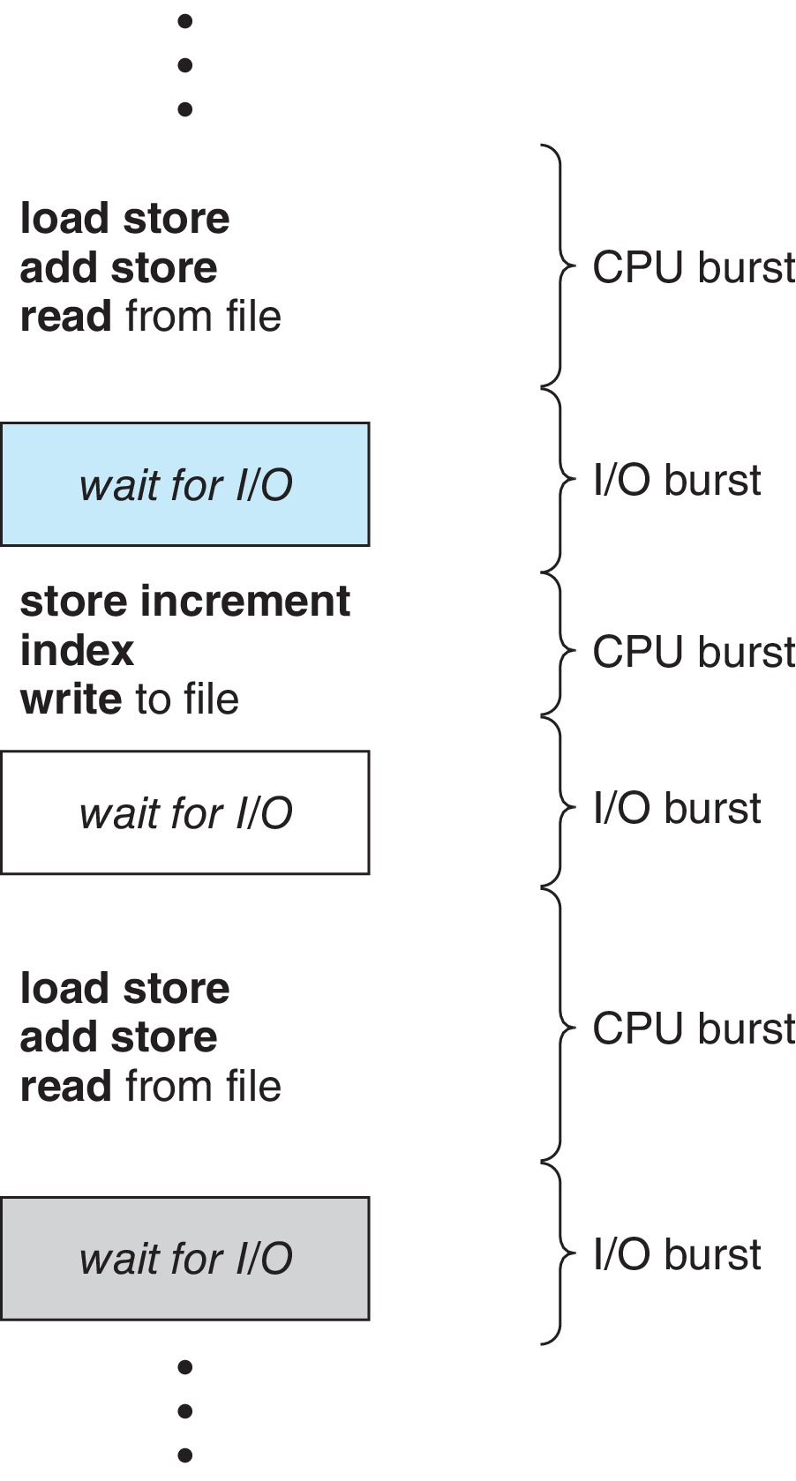
Basic Concepts
CPU–I/O Burst Cycle – Process execution consists of a cycle of CPU execution and I/O wait
Process execution begins with CPU burst followed by I/O burst
CPU burst distribution is of main concern

Slide 6
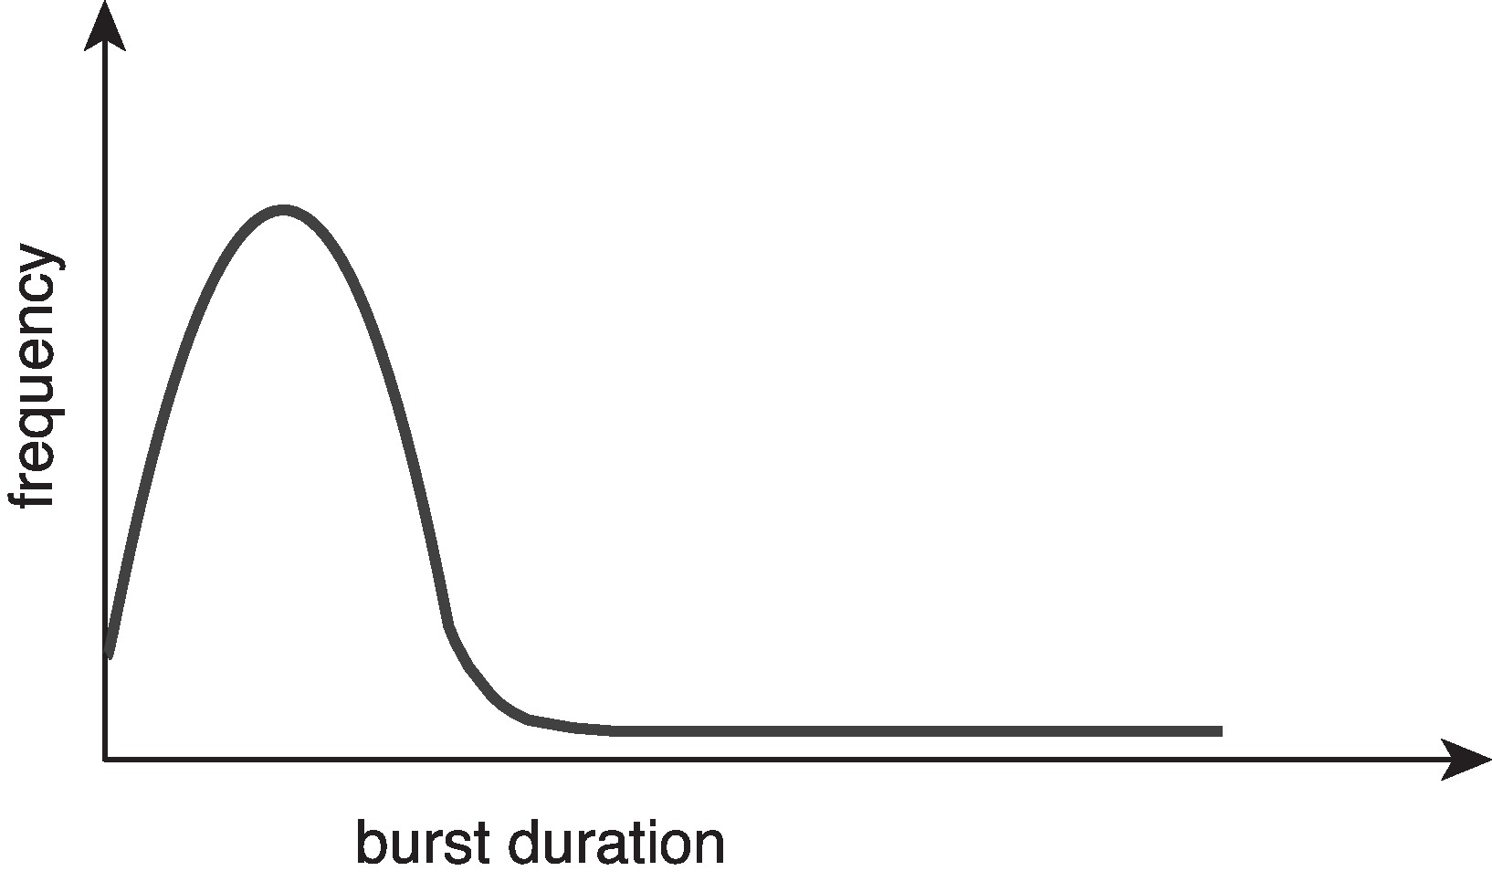
Histogram of CPU-burst Times
Large number of short bursts
Small number of longer bursts
Histogram
An I/O-bound program typically has many short CPU bursts.
A CPU-bound program might have a few long CPU bursts.
This distribution can be important when implementing a CPU-scheduling algorithm.

Slide 7
CPU Scheduler
The CPU scheduler selects from among the processes in ready queue, and allocates a CPU core to one of them
The ready queue may be ordered in various ways
The ready queue can be implemented as a FIFO queue, a priority queue, a tree, or simply an unordered linked list.

Slide 8
Circumstances for CPU Scheduling
CPU scheduling decisions may take place when a process:
When a process switches from the running state to the waiting state (for example, as the result of an I/O request or an invocation of wait() for the termination of a child process)
When a process switches from the running state to the ready state (for example, when an interrupt occurs)
When a process switches from the waiting state to the ready state (for example, at completion of I/O)
When a process terminates
For situations 1 and 4, there is no choice in terms of scheduling. A new process (if one exists in the ready queue) must be selected for execution.
For situations 2 and 3, however, there is a choice.

Slide 9
Preemptive and Nonpreemptive Scheduling
When scheduling takes place only under circumstances 1 and 4, the scheduling scheme is nonpreemptive.
Otherwise, it is preemptive.
Under Nonpreemptive scheduling, once the CPU has been allocated to a process, the process keeps the CPU until it releases it either by terminating or by switching to the waiting state.
Virtually all modern operating systems including Windows, MacOS, Linux, and UNIX use preemptive scheduling algorithms.

Slide 10
Preemptive Scheduling and Race Conditions
Preemptive scheduling can result in race conditions when data are shared among several processes.
Consider the case of two processes that share data. While one process is updating the data, it is preempted so that the second process can run. The second process then tries to read the data, which are in an inconsistent state.
This issue will be explored in detail in Chapter 6.

Slide 11
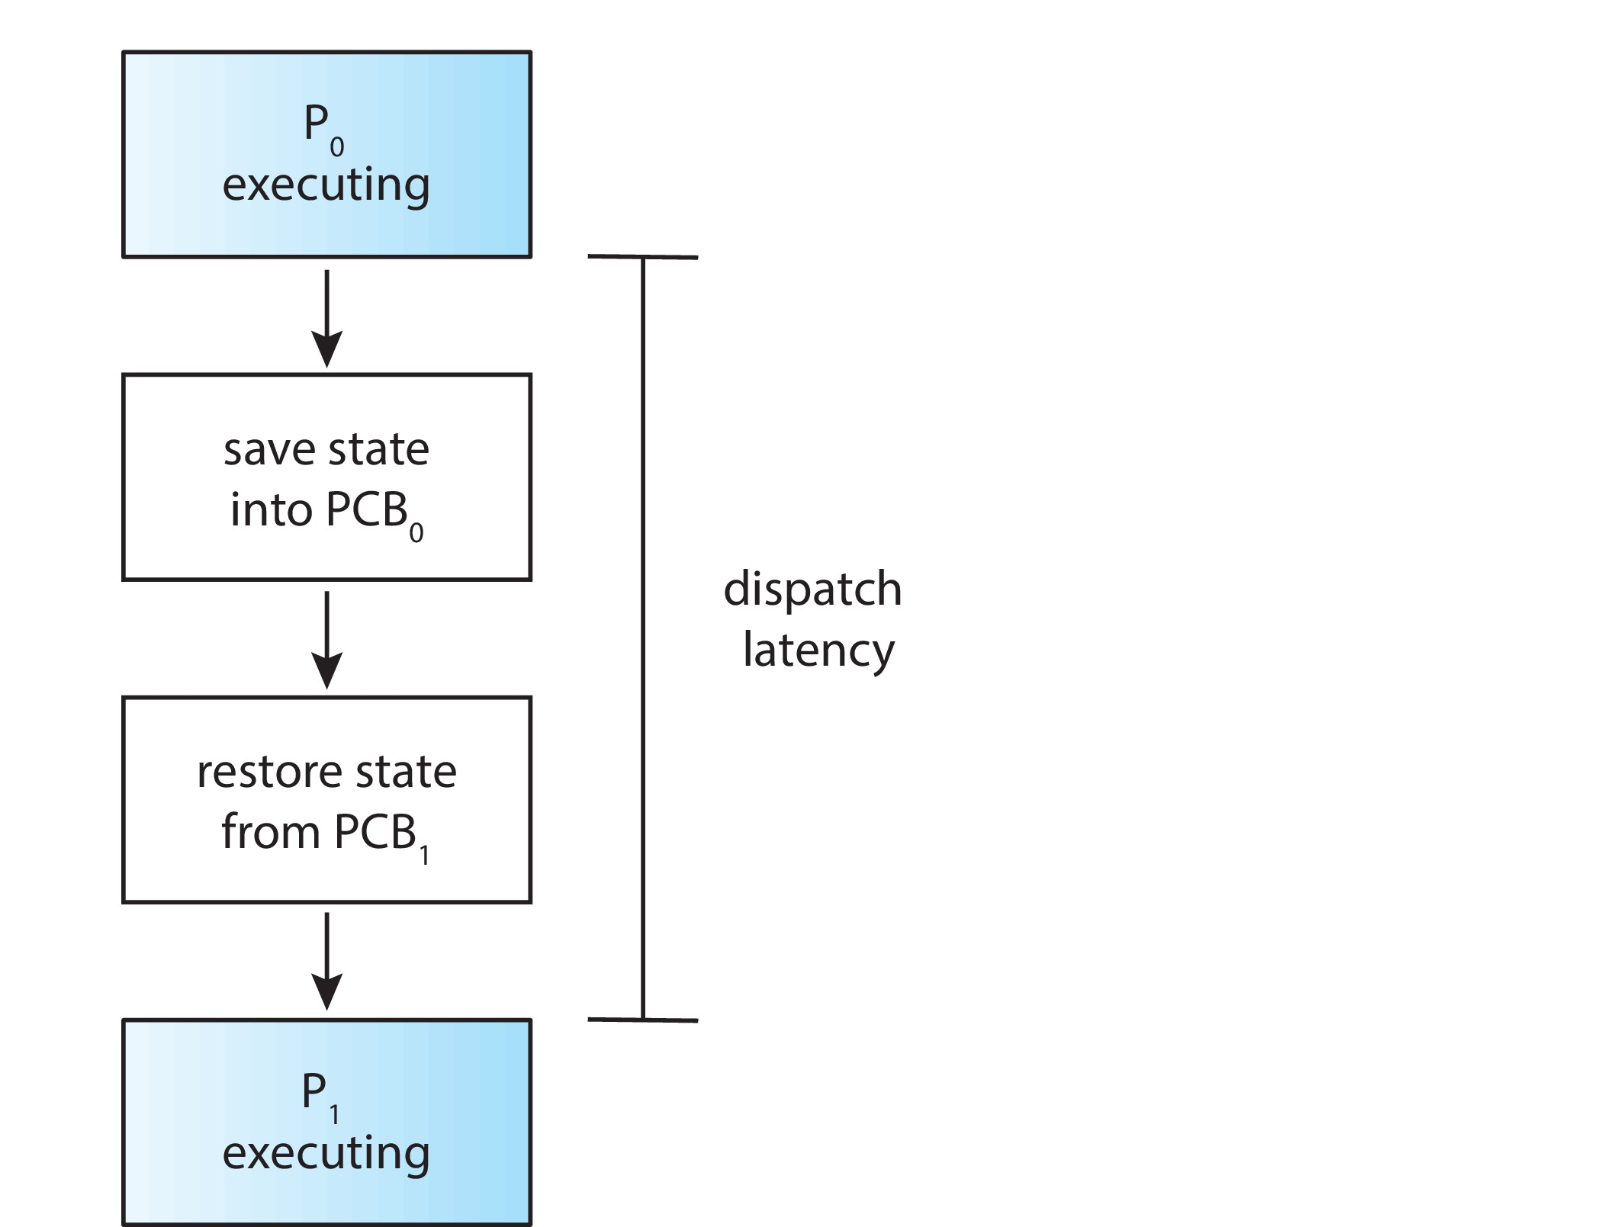
Dispatcher
Dispatcher module gives control of the CPU to the process selected by the CPU scheduler; this involves:
Switching context
Switching to user mode
Jumping to the proper location in the user program to restart that program
Dispatch latency – time it takes for the dispatcher to stop one process and start another running

Slide 12
Scheduling Criteria
CPU utilization – keep the CPU as busy as possible
Throughput – # of processes that complete their execution per time unit
Turnaround time – amount of time to execute a particular process
Waiting time – amount of time a process has been waiting in the ready queue
Response time – amount of time it takes from when a request was submitted until the first response is produced.

Slide 13
Optimization Criteria for Scheduling Algorithms
Max CPU utilization
Max throughput
Min turnaround time
Min waiting time
Min response time

Slide 14
First- Come, First-Served (FCFS) Scheduling
Example with 3 processes
Process Burst Time
P₁ 24
P₂ 3
P₃ 3
Suppose that the processes arrive in the order: P₁ , P₂ , P₃ The Gantt Chart for the above schedule is:
Waiting time for P₁ = 0; P₂ = 24; P₃ = 27
Average waiting time: (0 + 24 + 27)/3 = 17

Slide 15
FCFS Scheduling (Cont.)
Suppose that the processes arrive in the order:
P₂ , P₃ , P₁
The Gantt chart for the schedule is:
Waiting time for P₁ = 6; P₂ = 0; P₃ = 3
Average waiting time: (6 + 0 + 3)/3 = 3
Much better than previous case
Convoy effect - short process behind long process
Consider one CPU-bound and many I/O-bound processes

Slide 16
FCFS Scheduling (Cont.)
Convoy effect
Assume we have one CPU-bound process and many I/O-bound processes.
The CPU-bound process will get and hold the CPU. During this time, all the other processes will finish their I/O and will move into the ready queue, waiting for the CPU.
While the processes wait in the ready queue, the I/O devices are idle.
Eventually, the CPU-bound process finishes its CPU burst and moves to an I/O device.
All the I/O-bound processes, which have short CPU bursts, execute quickly and move back to the I/O queues. At this point, the CPU sits idle. The CPU-bound process will then move back to the ready queue and be allocated the CPU.
Again, all the I/O processes end up waiting in the ready queue until the CPU-bound process is done.
There is a convoy effect as all the other processes wait for the one big process to get off the CPU.
This effect results in lower CPU and device utilization than might be possible if the shorter processes were allowed to go first.

Slide 17
Shortest-Job-First (SJF) Scheduling
Associate with each process the length of its next CPU burst
Use these lengths to schedule the process with the shortest time
SJF is optimal – gives minimum average waiting time for a given set of processes
How do we determine the length of the next CPU burst?
Could ask the user
Estimate

Slide 18
Example of SJF
ProcessArriv l Time Burst Time
P₁ 0.0 6
P₂ 2.0 8
P₃ 4.0 7
P₄ 5.0 3
SJF scheduling chart
Average waiting time = (3 + 16 + 9 + 0) / 4 = 7

Slide 19

Determining Length of Next CPU Burst
Can only estimate the length – should be similar to the previous one
Then pick process with shortest predicted next CPU burst
Can be done by using the length of previous CPU bursts, using exponential averaging
Commonly, α set to ½

Slide 20
Shortest Remaining Time First Scheduling
Preemptive version of SJN
Whenever a new process arrives in the ready queue, the decision on which process to schedule next is redone using the SJN algorithm.
Is SRT more “optimal” than SJN in terms of the minimum average waiting time for a given set of processes?

Slide 21
Example of Shortest-remaining-time-first
Now we add the concepts of varying arrival times and preemption to the analysis
ProcessA arri Arrival TimeT Burst Time
P₁ 0 8
P₂ 1 4
P₃ 2 9
P₄ 3 5
Preemptive SJF Gantt Chart
Average waiting time = [(10-1)+(1-1)+(17-2)+(5-3)]/4 = 26/4 = 6.5

Slide 22
Round Robin (RR)
Each process gets a small unit of CPU time (time quantum q), usually 10-100 milliseconds. After this time has elapsed, the process is preempted and added to the end of the ready queue.
If there are n processes in the ready queue and the time quantum is q, then each process gets 1/n of the CPU time in chunks of at most q time units at once. No process waits more than (n-1)q time units.
Timer interrupts every quantum to schedule next process
Performance
q large ⇒ FIFO
q small ⇒ q must be large with respect to context switch, otherwise overhead is too high

Slide 23
Example of RR with Time Quantum = 4
Process Burst Time
P₁ 24
P₂ 3
P₃ 3
The Gantt chart is:
Typically, higher average turnaround than SJF, but better response
q should be large compared to context switch time
q usually 10 milliseconds to 100 milliseconds,
Context switch < 10 microseconds

Slide 24
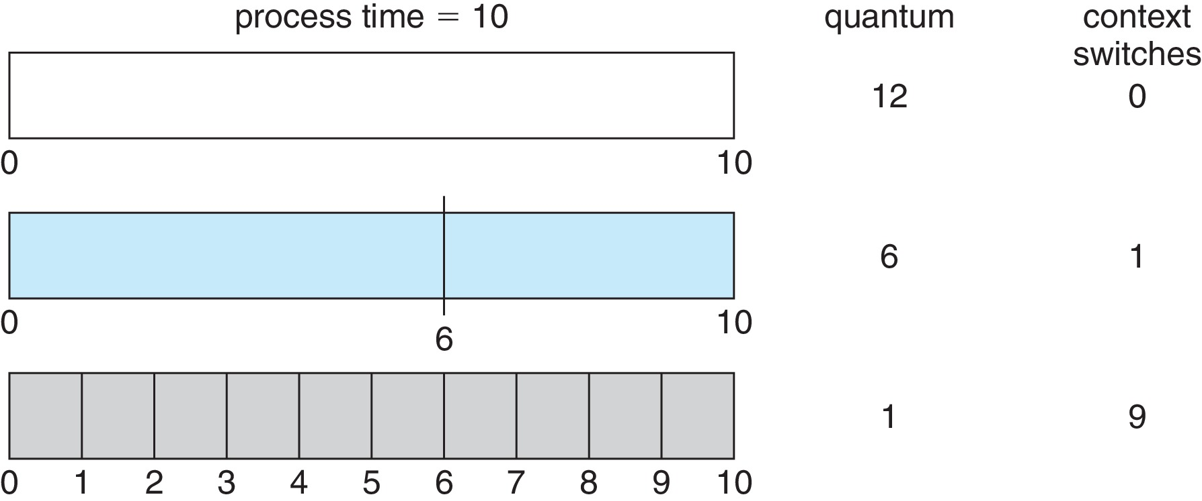
Time Quantum and Context Switch Time

Slide 25
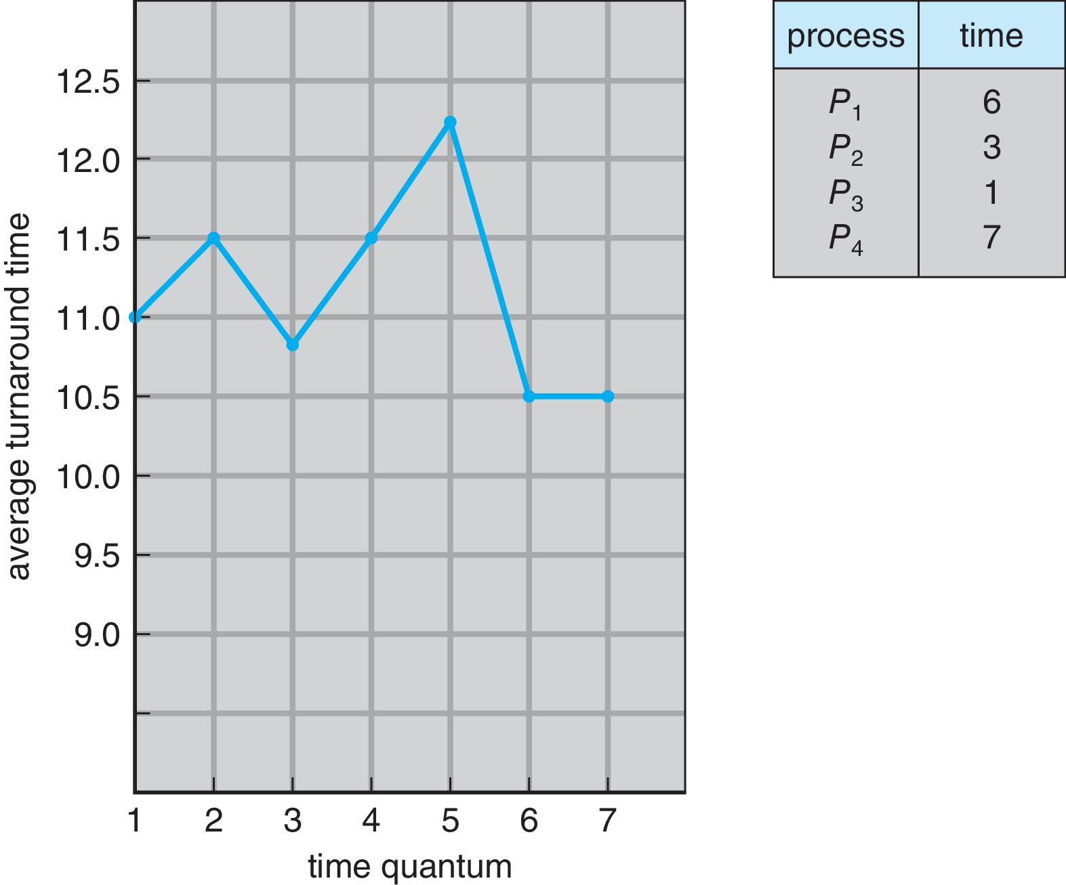
Turnaround Time Varies With The Time Quantum
80% of CPU bursts should be shorter than q

Slide 26
Priority Scheduling
A priority number (integer) is associated with each process
The CPU is allocated to the process with the highest priority (usually, smallest integer ≡ highest priority)
Two schemes:
Preemptive
Nonpreemptive
Problem ≡ Starvation – low priority processes may never execute
Solution ≡ Aging – as time progresses increase the priority of the process
Note: SJF is priority scheduling where priority is the inverse of predicted next CPU burst time

Slide 27
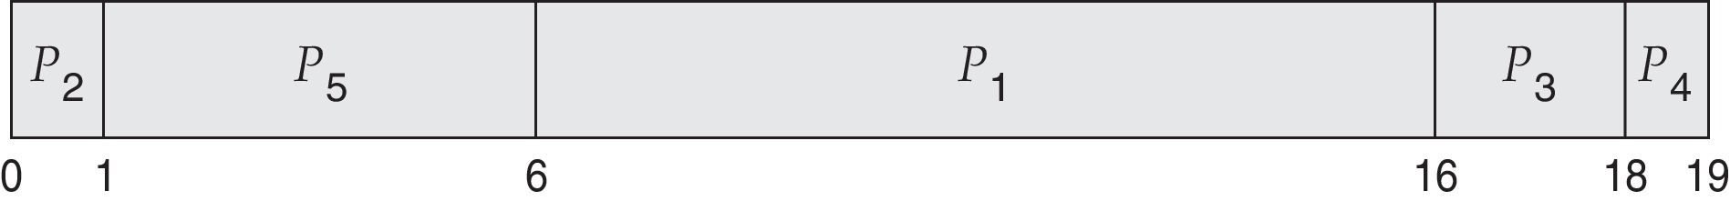
Example of Priority Scheduling
ProcessA arri Burst TimeT Priority
P₁ 10 3
P₂ 1 1
P₃ 2 4
P₄ 1 5
P₅ 5 2
Priority scheduling Gantt Chart
Average waiting time = 8.2

Slide 28
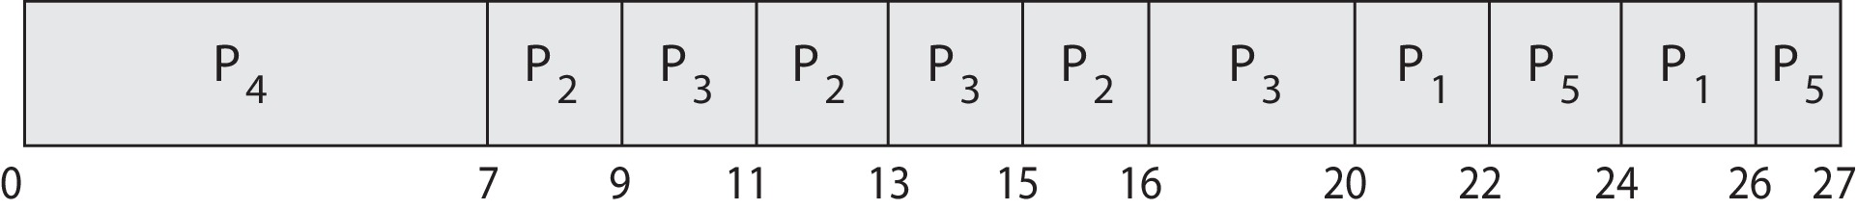
Priority Scheduling w/ Round-Robin
Run the process with the highest priority. Processes with the same priority run round-robin
Example:
Process a Burst Time Priority
P₁ 4 3
P₂ 5 2
P₃ 8 2
P₄ 7 1
P₅ 3 3
Gantt Chart with time quantum = 2

Slide 29
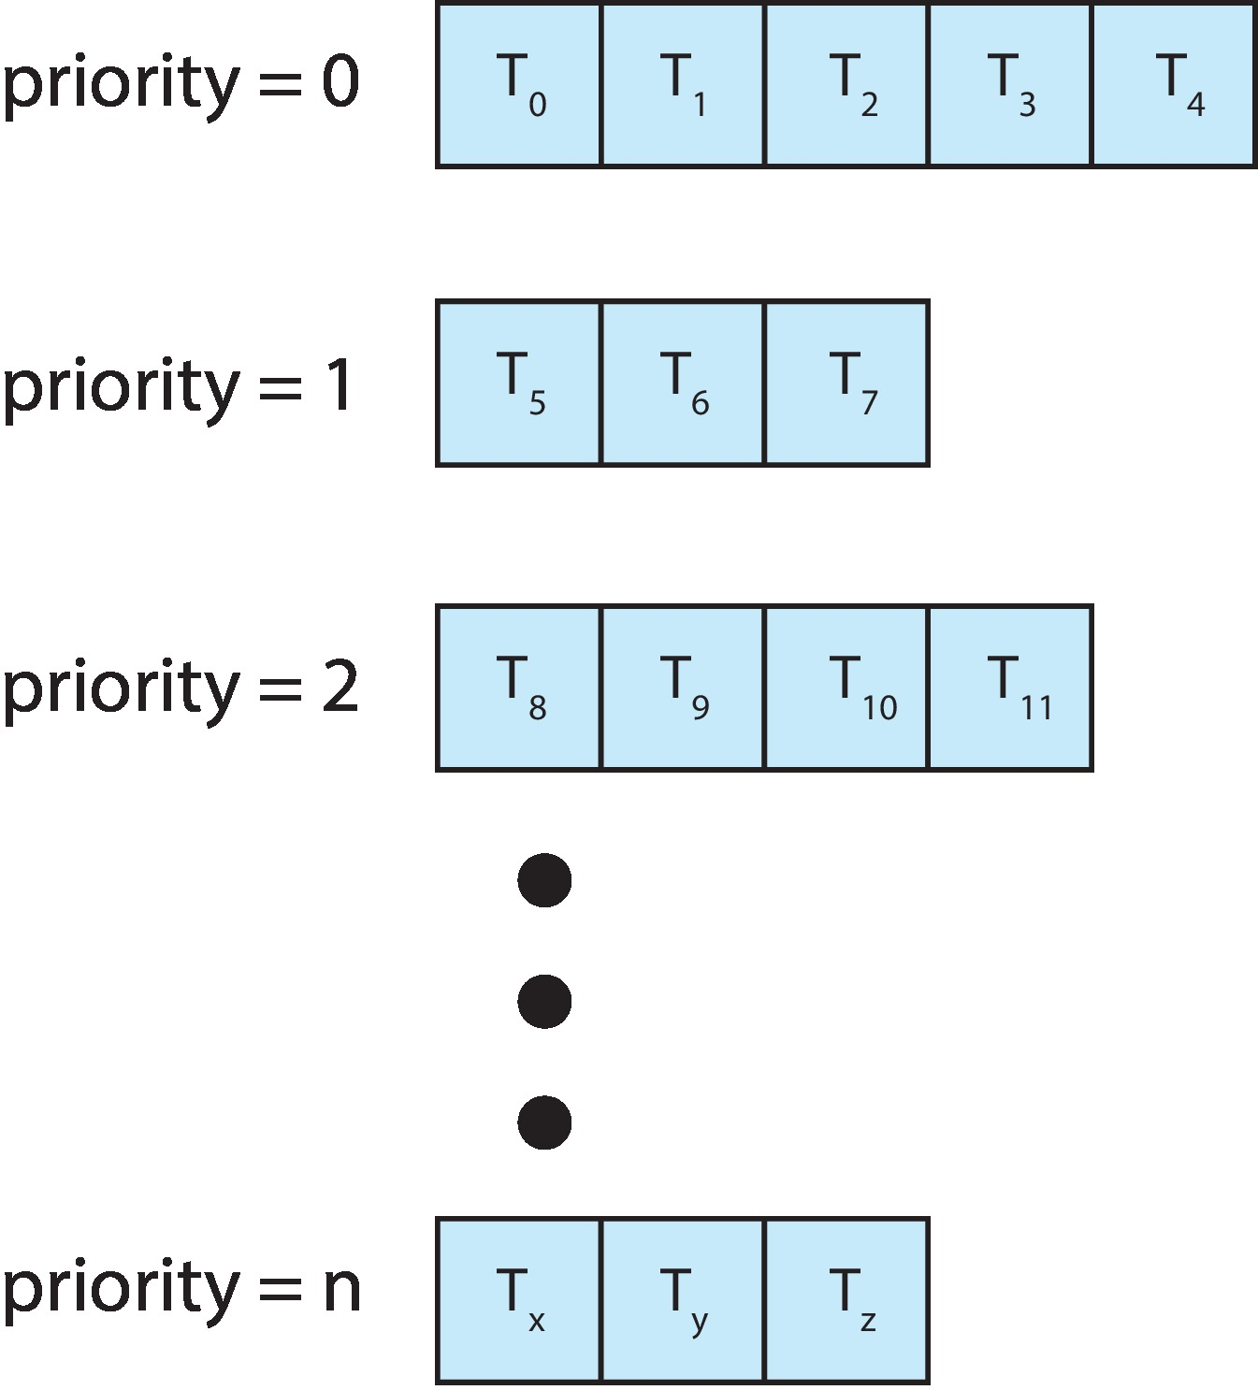
Multilevel Queue
The ready queue consists of multiple queues
Example:
Priority scheduling, where each priority has its separate queue.
Schedule the process in the highest-priority queue!

Slide 30
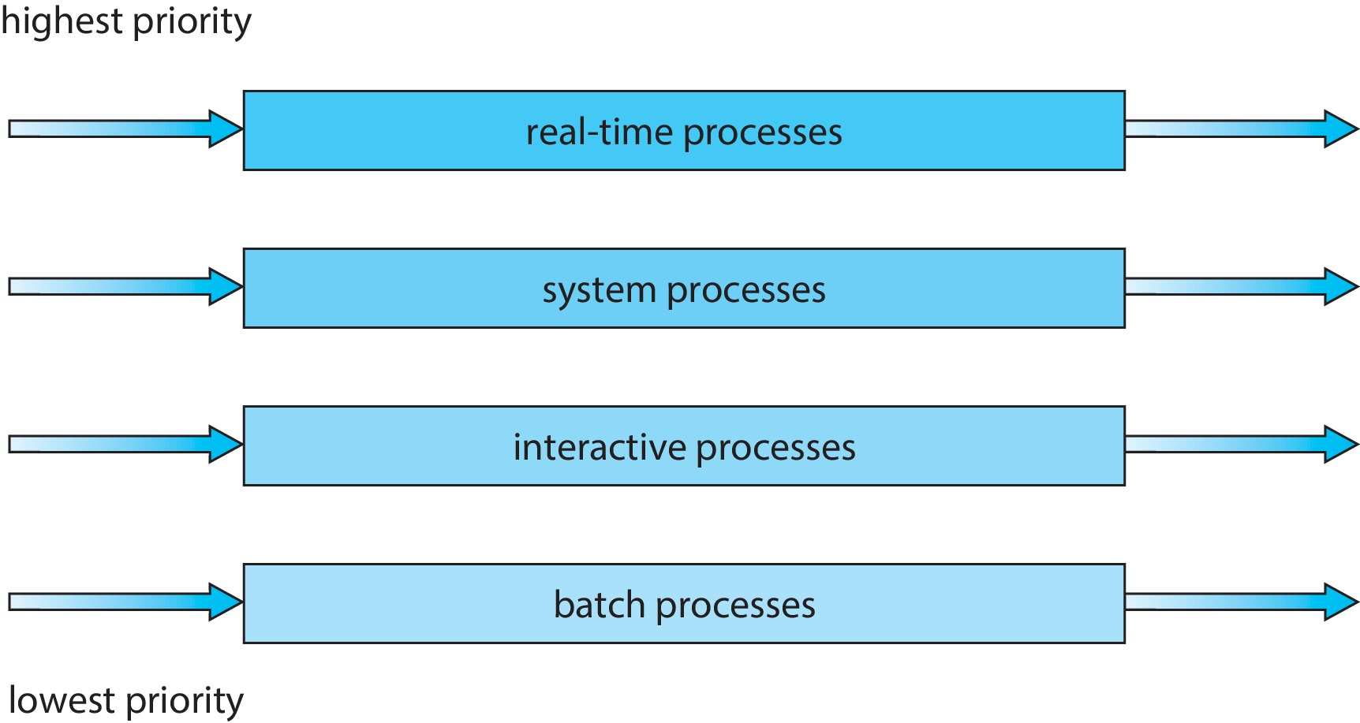
Multilevel Queue
Prioritization based upon process type

Slide 31
Multilevel Feedback Queue
A process can move between the various queues.
Multilevel-feedback-queue scheduler defined by the following parameters:
Number of queues
Scheduling algorithms for each queue
Method used to determine when to upgrade a process
Method used to determine when to demote a process
Method used to determine which queue a process will enter when that process needs service
Aging can be implemented using multilevel feedback queue

Slide 32
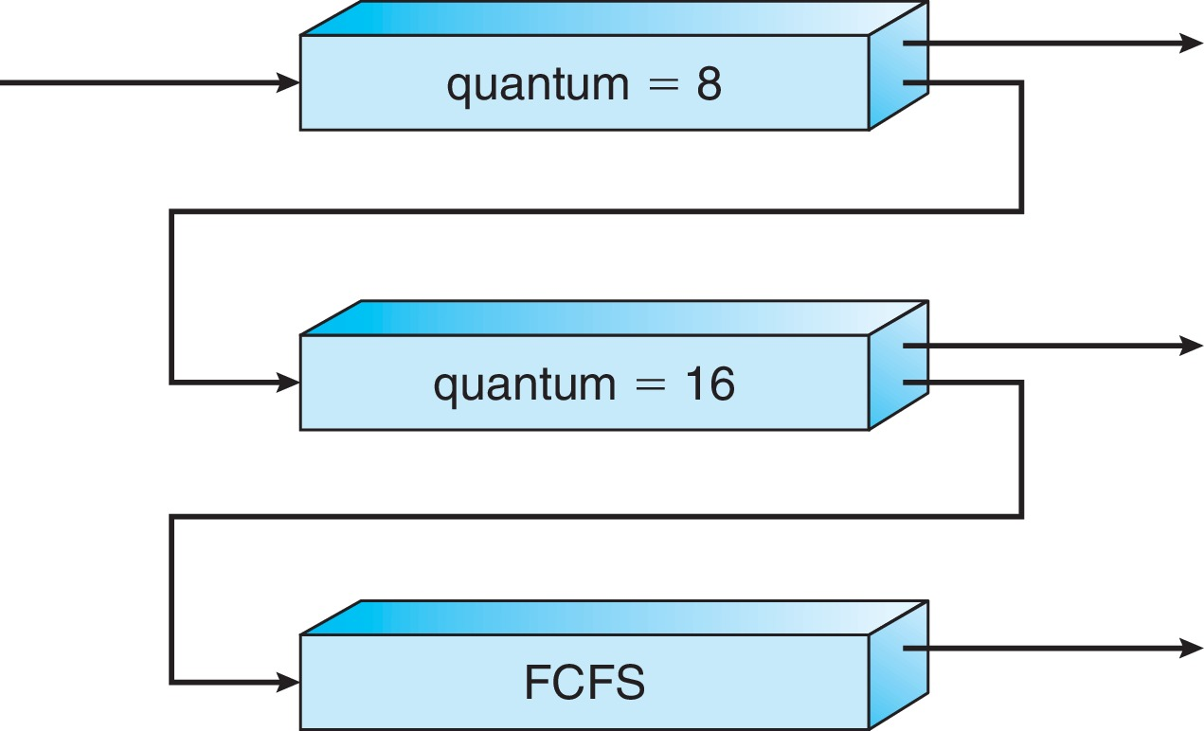
Example of Multilevel Feedback Queue
Three queues:
Q₀ – RR with time quantum 8 milliseconds
Q₁ – RR time quantum 16 milliseconds
Q₂ – FCFS
Scheduling
A new process enters queue Q₀ which is served in RR
When it gains CPU, the process receives 8 milliseconds
If it does not finish in 8 milliseconds, the process is moved to queue Q₁
At Q₁ job is again served in RR and receives 16 additional milliseconds
If it still does not complete, it is preempted and moved to queue Q₂

Slide 33
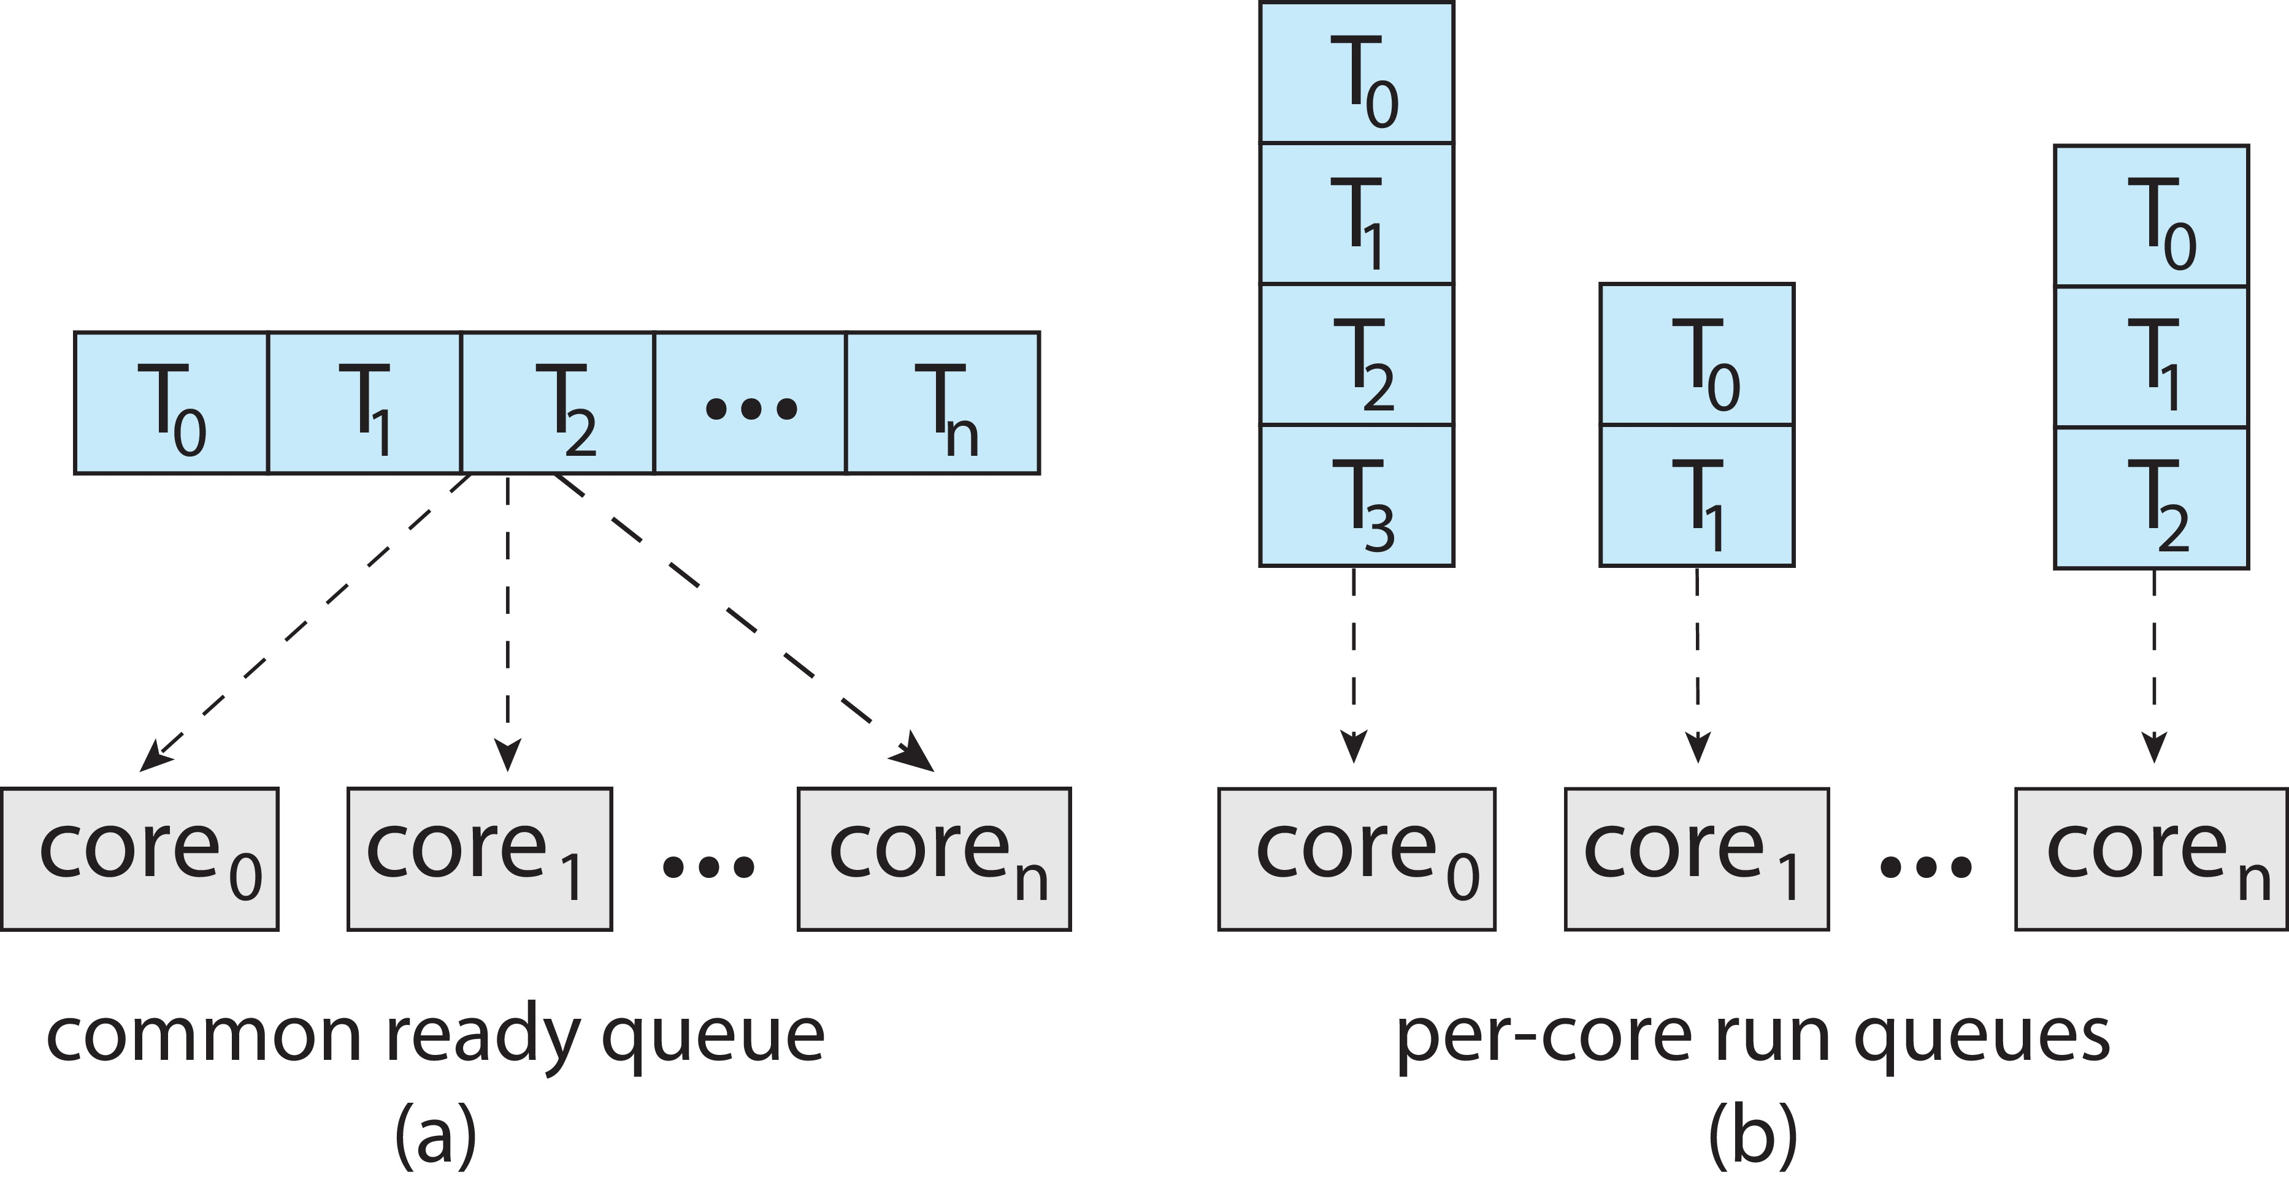
Multiple-Processor Scheduling
Symmetric multiprocessing (SMP) is where each processor is self scheduling.
All threads may be in a common ready queue (a)
Each processor may have its own private queue of threads (b)

Slide 34
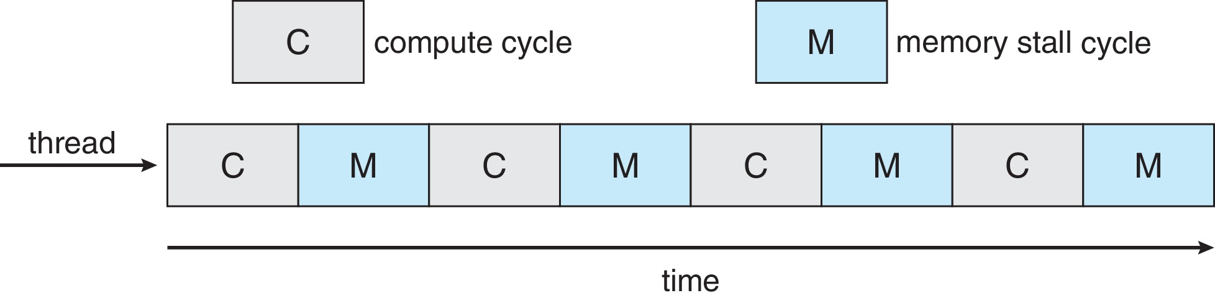
Multicore Processors
Recent trend to place multiple processor cores on same physical chip
Faster and consumes less power
Multiple threads per core also growing
Takes advantage of memory stall to make progress on another thread while memory retrieve happens
Figure

Slide 35
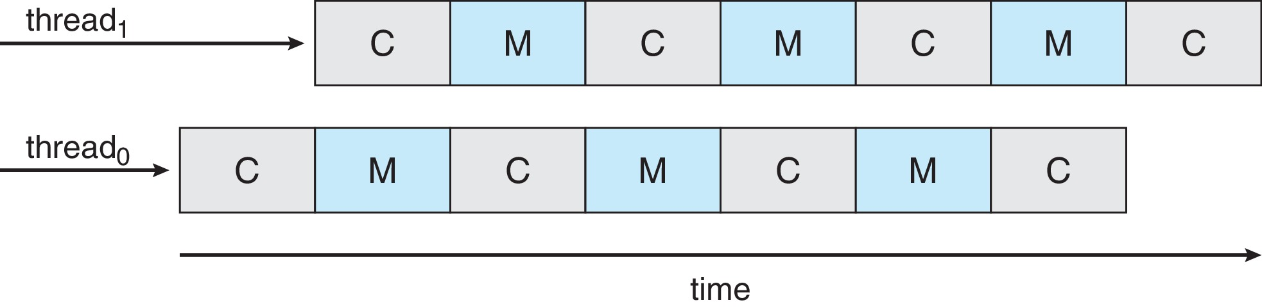
Multithreaded Multicore System
Each core has > 1 hardware threads.
If one thread has a memory stall, switch to another thread!
Figure

Slide 36
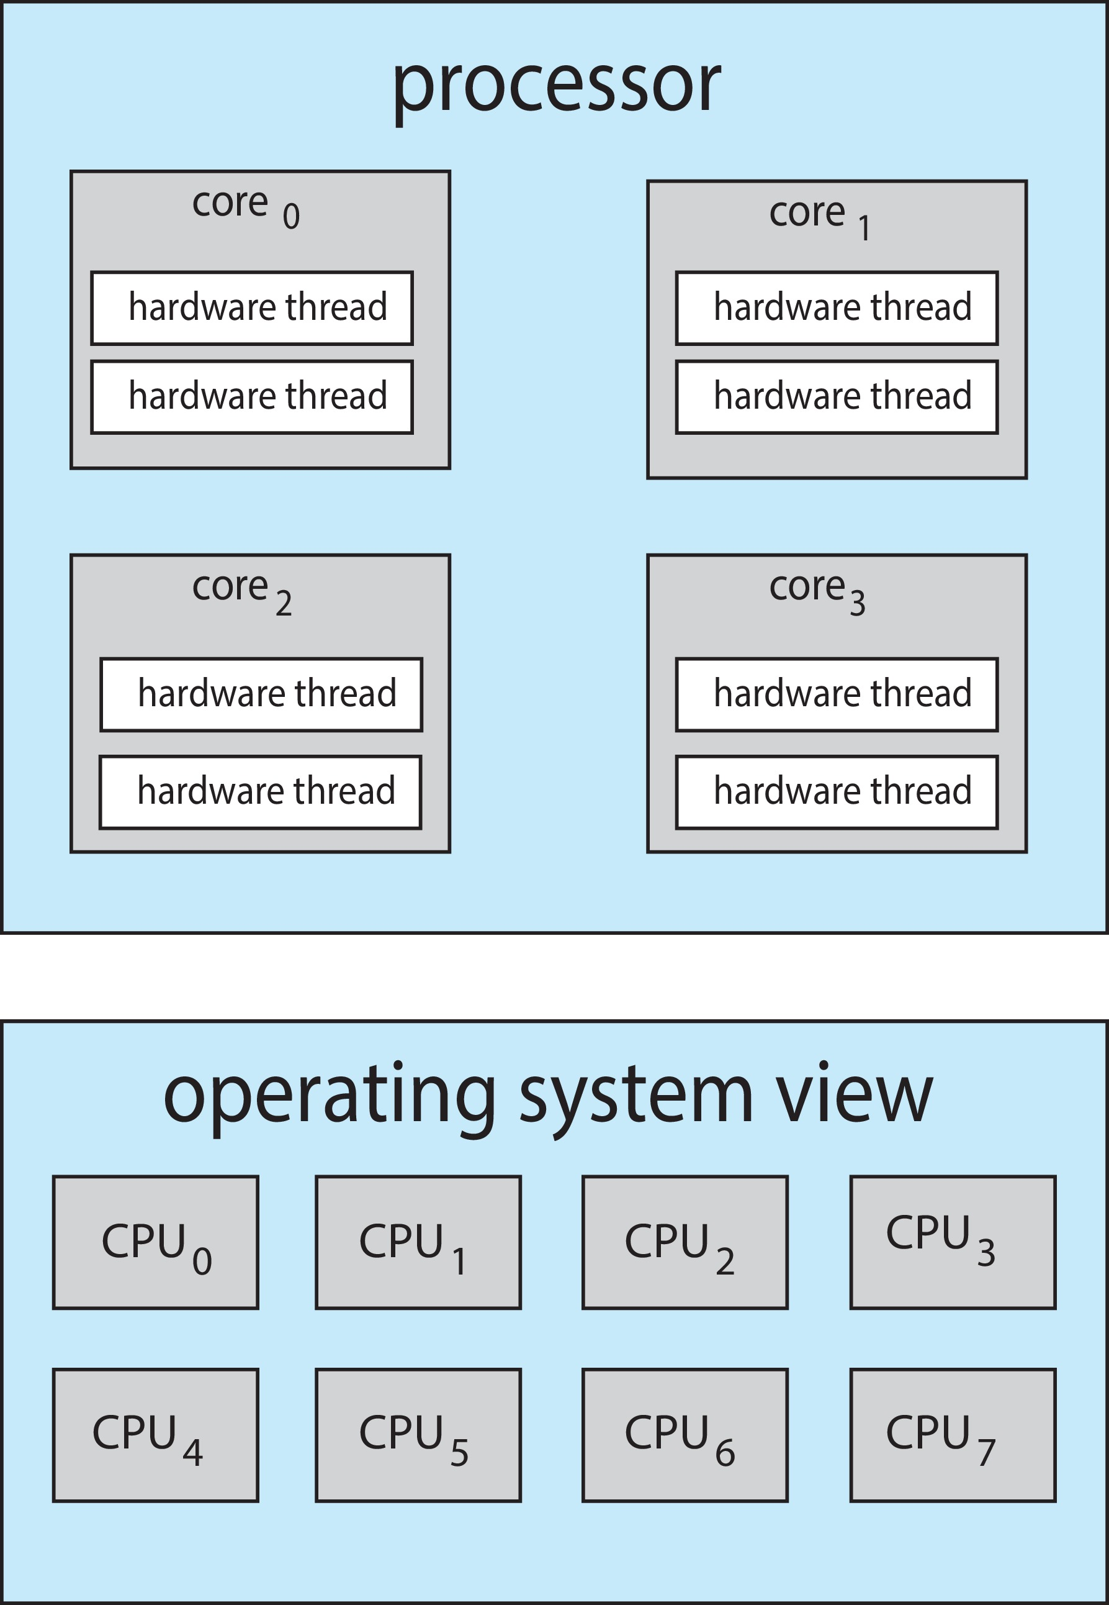
Multithreaded Multicore System
Chip-multithreading (CMT) assigns each core multiple hardware threads. (Intel refers to this as hyperthreading.)
On a quad-core system with 2 hardware threads per core, the operating system sees 8 logical processors.

Slide 37
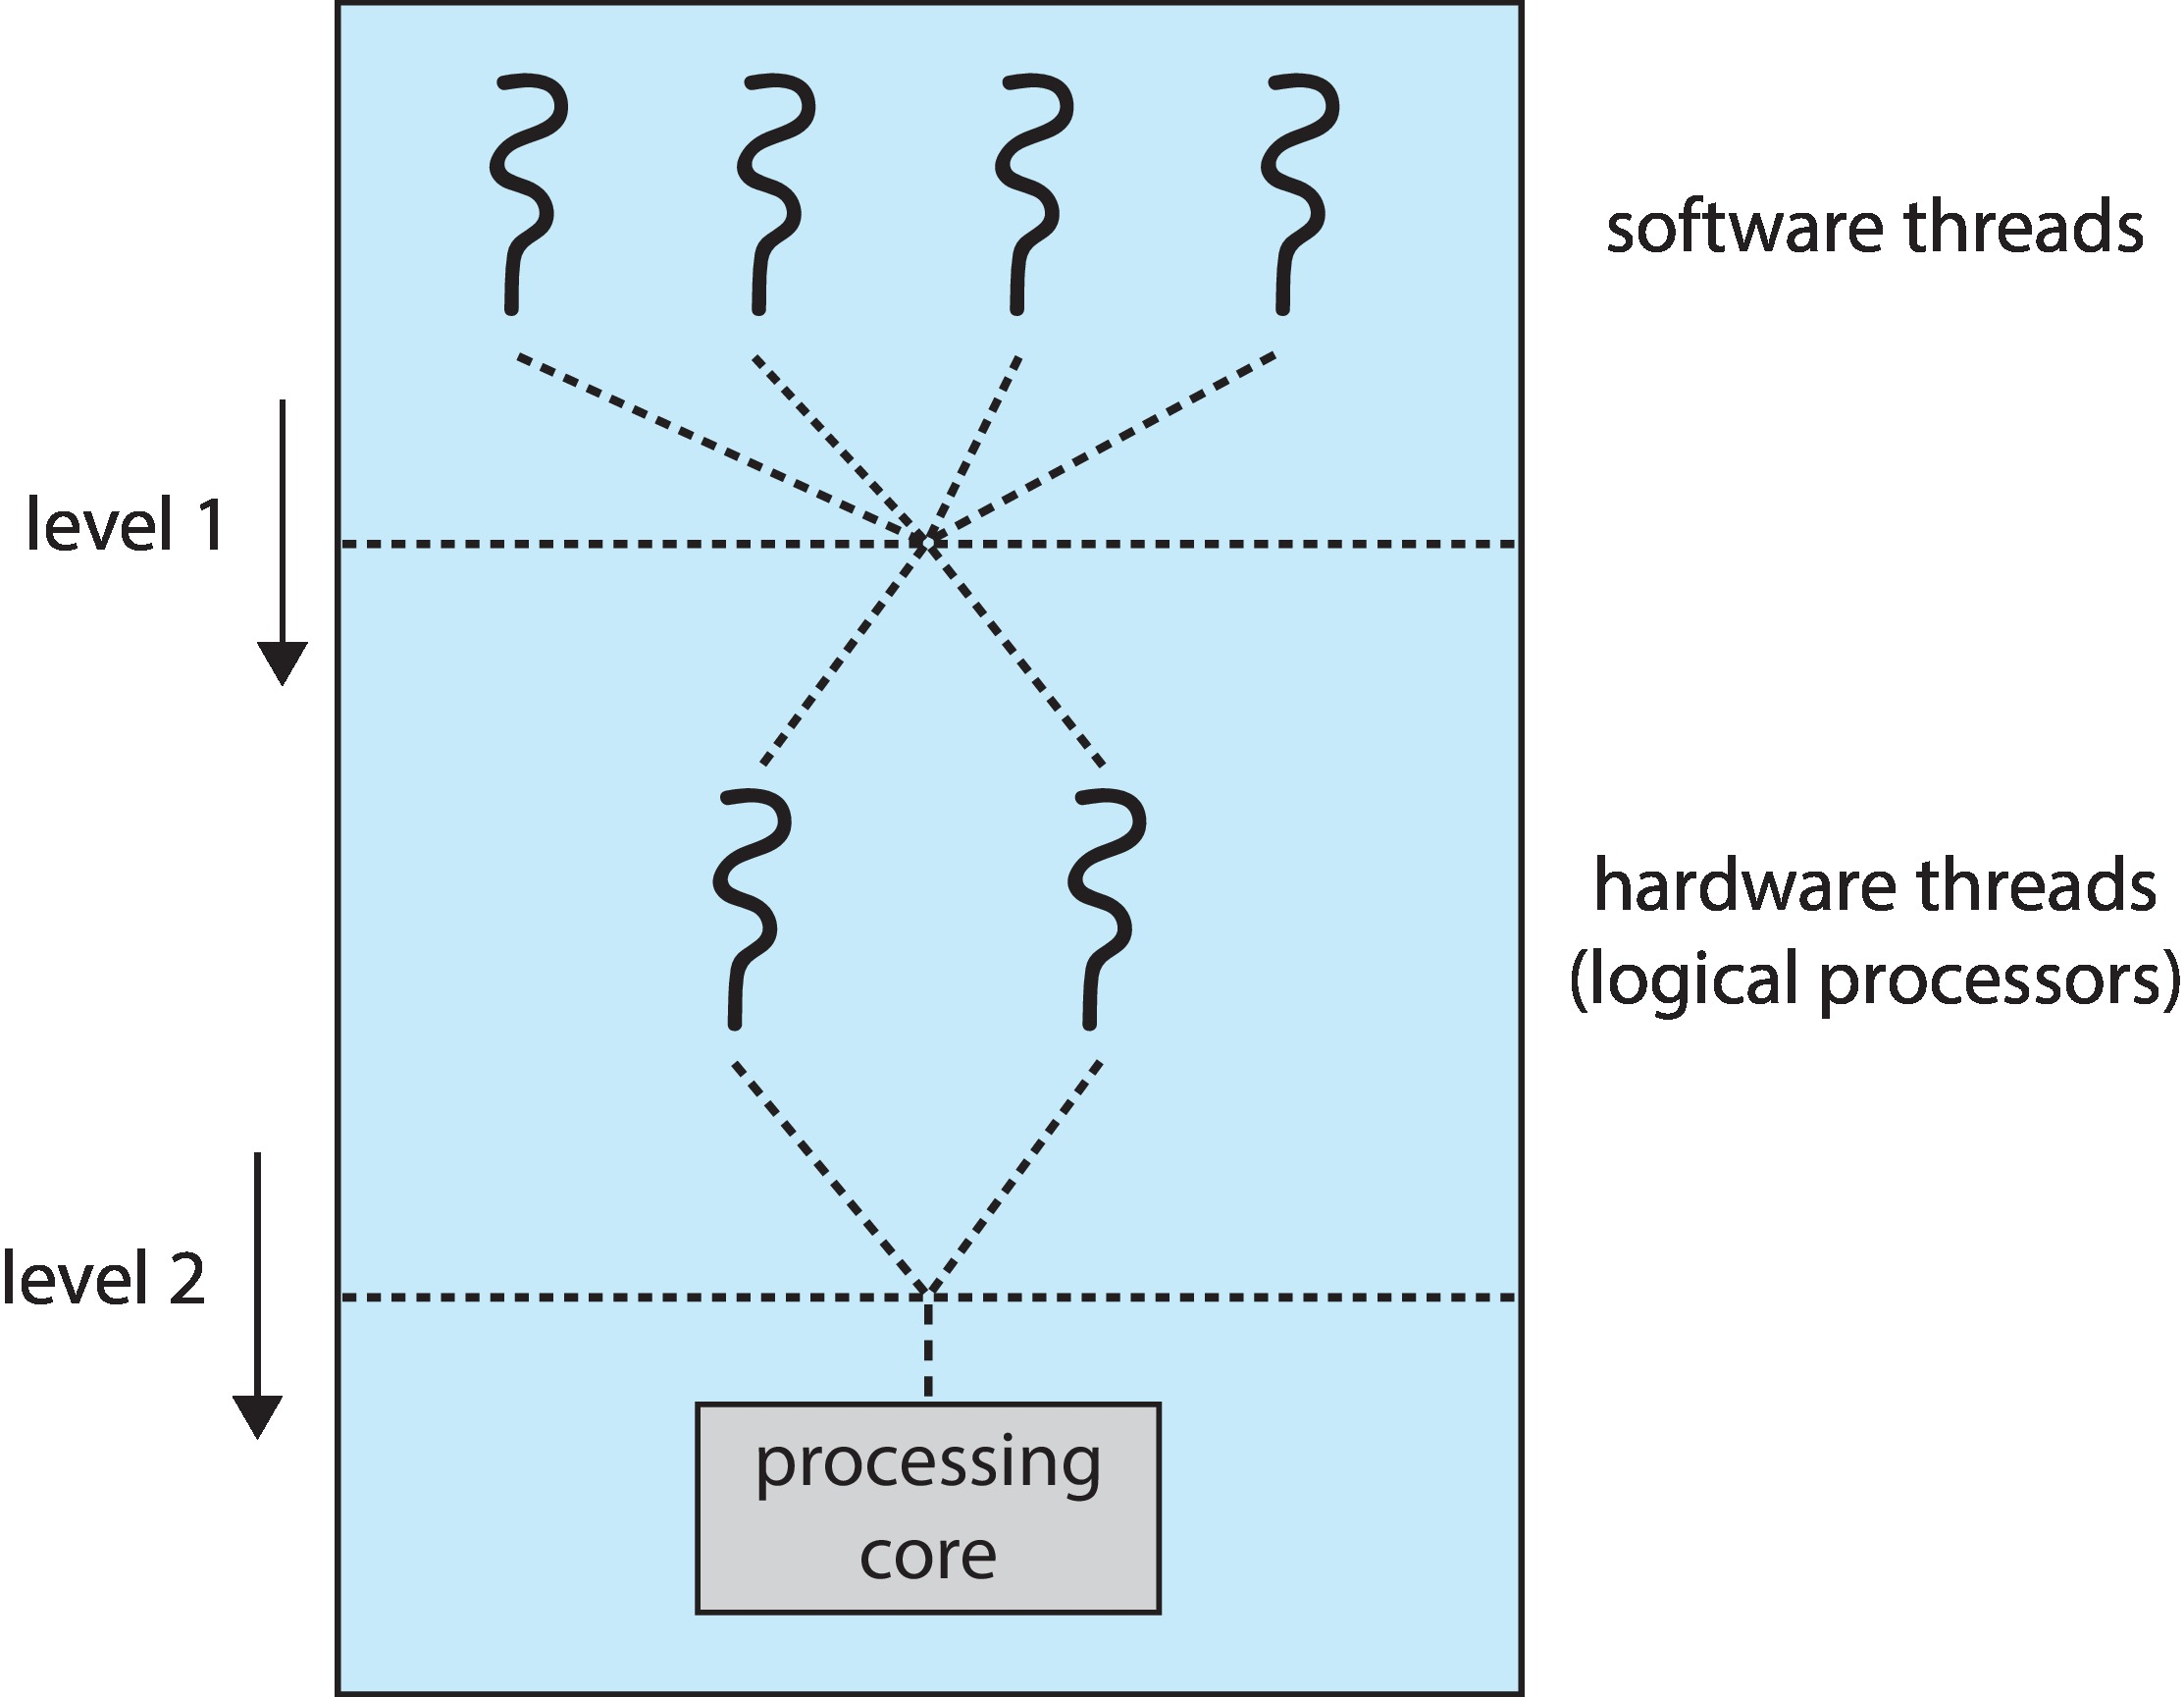
Multithreaded Multicore System
Two levels of scheduling:
The operating system deciding which software thread to run on a logical CPU
How each core decides which hardware thread to run on the physical core.

Slide 38
End of Chapter 5

